Slide 1
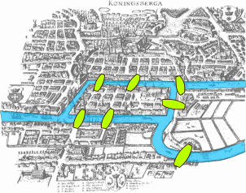
Graph Theory
Pregel
http://en.wikipedia.org/wiki/Leonhard_Euler

Slide 2
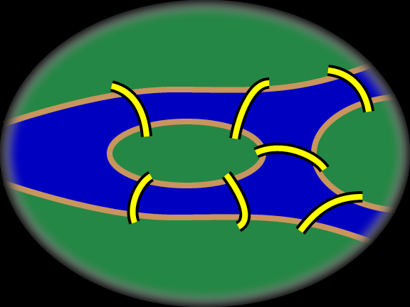
Leonard Euler (1707-1783)
He solved the «seven bridges of Köningsberg» problem using graph theoretical ideas.

Slide 3
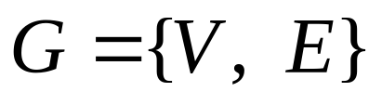
Definition of a Graph
Undirected graph: E contains 2-element subsets of V.
1
1
2
Set of vertices(nodes)
Set of edges(arrows)
2
9
6
7
3
3
Digraph (Directed Graph):
E contains ordered 2-element subsets (pairs) of V.
8
6
4
4
5
5
1
1
2
2
We use directed graphs for the analysis of electrical circuits. WHY?
9
6
7
3
3
8
4
6
4
5
5

Slide 4
Element Graph
For each n-terminal circuit element we can associate a graph with n nodes and n-1 arrows.
Element graph for a 2-terminal element:
1
1
İ₁ (t)
+
1
v₁ (t)
_
2
2

Slide 5
Element graph for a 3-terminal element:
1
2
_
V₂₁
+
1
İ₁ (t)
_
2
+
İ₂ (t)
3
3-terminal
element
1
2
V₁₃
V₃₂
3
İ₃ (t)
_
+
1
2
3
Which one? How to choose?
3

Slide 6
Choose a reference node for the element!
1
İ₁ (t)
İ₂ (t)
+
2
+
1
2
İ₁ (t)
İ₂ (t)
V₁
V₂
_
_
3
3
Reference node is 3.

Slide 7
+
V₁
_
_
1
İ₁ (t)
2
İ₁ (t)
1
2
Reference node is 2.
V₃
İ₃ (t)
İ₃ (t)
+
3
3
_
V₂
+
1
_
İ₂ (t)
2
İ₂ (t)
1
2
Reference node is 1.
V₃
İ₃ (t)
İ₃ (t)
+
3
3

Slide 8
Element graph for an n-terminal element:
2
1
İ₁ (t)
İ₂ (t)
k
İ_{k}(t)
1
2
k
n-terminal element
n-1
İ₁ (t)
İ_{k}(t)
İ₂ (t)
İ_{n-1} (t)
İ_{n-1}(t)
n
n
n-1

Slide 9
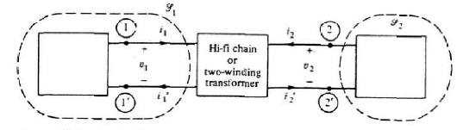
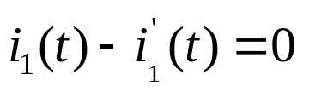
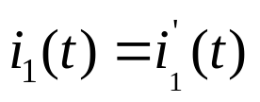
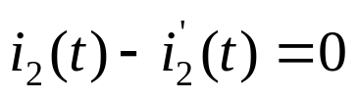
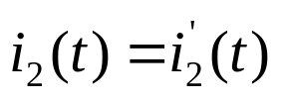
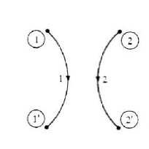
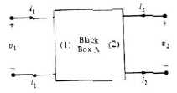
2-ports
Write KCL for the Gaussian surface S₁:
Write KCL for the Gaussian surface S₂:
Element graph for 2-ports:
Port conditions
L.O. Chua, C.A. Desoer, S.E. Kuh. “Linear and Nonlinear Circuits”, Mc.Graw Hill, 1987, New York

Slide 10
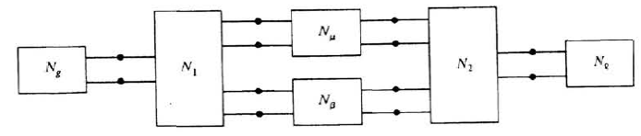
n-ports
Element graph for n-ports:
_
v₁
+
i₁
?
n-port
element
_
i_{n}
v_{n}
+

Slide 11
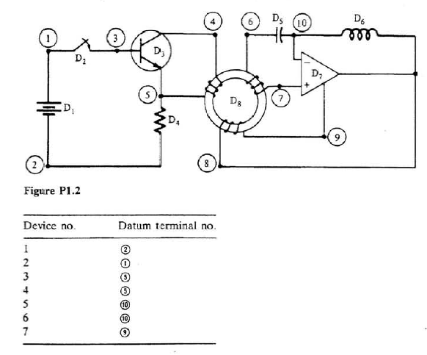
Circuit Graph
A circuit can be represented by a digraph, called a circuit graph, that depicts the interconnection of circuit elements and the reference directions of elements.

Slide 12
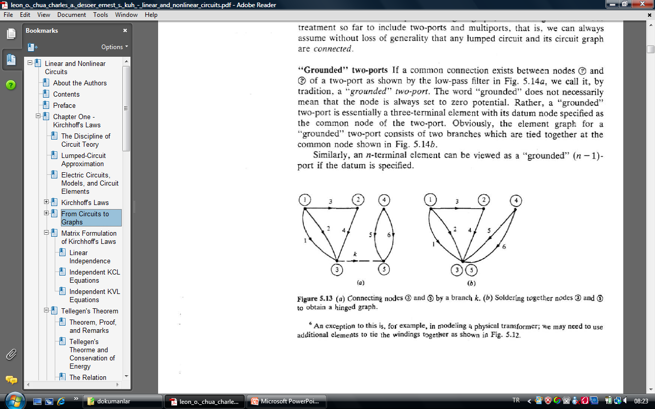

Circuit graphs of connected circuits with n-ports may not be connected!
Write KCL for the Gaussian surface S₁ :
S₁
L.O. Chua, C.A. Desoer, S.E. Kuh. “Linear and Nonlinear Circuits”, Mc.Graw Hill, 1987, New York

Slide 13
Some Definitions in Graph Theory
Definition: (Degree)
Degree of a node is the number of edges(arrows) connected to the node.
Definition: (Path)
A path P is a subgraph of G that satisfies the following properties:
P has n edges and n+1 nodes.
The edges and nodes in P can be enumerated as e₁, e₂, ...,e_{n} and n₁,n₂, ....,n_{n+1} such that, the edge e_{k} connects the nodes n_{k} ve n_{k+1}.
n₁ and n_{n+1} has degree 1 and all the other nodes has degree 2.
Definition: (Connected Graph)
A graph G is called connected if for any pair of nodes there exists a path that connects these nodes.

Slide 14
Definition: (Loop (Çevre))
A loop L is a subgraph of G that satisfies the following properties:
L is connected.
Each node in L has degree 2.
Definition: (Cut-set (Kesitleme))
Let G be a connected graph. A cut-set C is a set of edges in G that satisfies the following properties:
G’={N,E-C} is not connected.
If an edge from C is added to G’, the graph becomes connected.
Definition: (Tree (Ağaç))
A tree T is a subgraph of G that satisfies the following properties:
T is connected.
T contains all nodes in G.
T contains no loops.
Definition: (Twig (Dal))
Edges of a tree are called twigs.
Definition: (Chord (Kiriş))
Edges of G that are not contained in tree T are called chords.

Slide 15
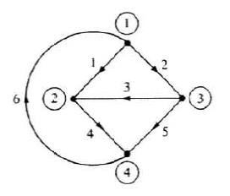
Some Results in Graph Theory
Theorem: (number of twigs)
A tree in a graph with n nodes and m edges has n-1 twigs and m-n+1 chords.
Theorem: (fundemantal loops – temel çevreler)
Each chord defines a loop that is a union of the chord and the path in tree between the nodes of the chord. Such a loop is called a fundamental loop.
Theorem: (fundamental cut-sets – temel kesitlemeler)
Each twig defines a unique cut-set that is a union of the twig and some chords. Such a cut-set is called a fundamental cut-set.

